Slide 1
CS 5683: Algorithms & Methods for Big Data Analytics Analysis of Large Graphs: Link Analysis and PageRank
Arunkumar Bagavathi
Department of Computer Science
Oklahoma State university

Slide 2
Course Topics Until Now
Frameworks
Graph Data
High. Dim. Data
Applications
Map Reduce
Locality Sensitive Hashing
Association Rules
PageRank
Dimensionality Reduction
Spark
Recommender Systems
Clustering

Slide 3
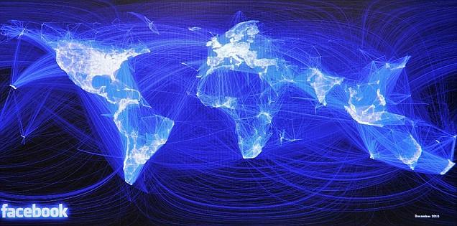
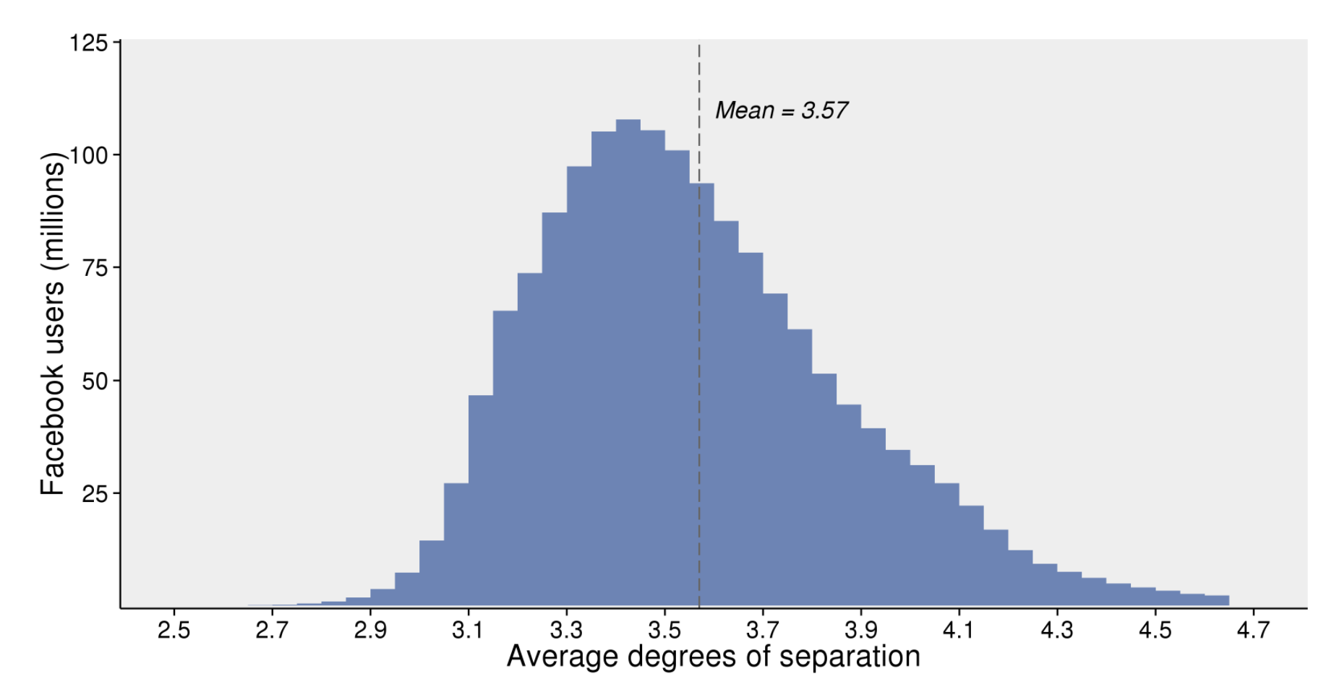
Graph Data: Social Networks
Facebook social graph
4-degrees of separation [Backstrom-Boldi-Rosa-Ugander-Vigna, 2011] with around 750 million people
UPDATED (2016): 3.57-degrees of separation [https://research.fb.com/blog/2016/02/three-and-a-half-degrees-of-separation] with 1.59 billion people

Slide 4
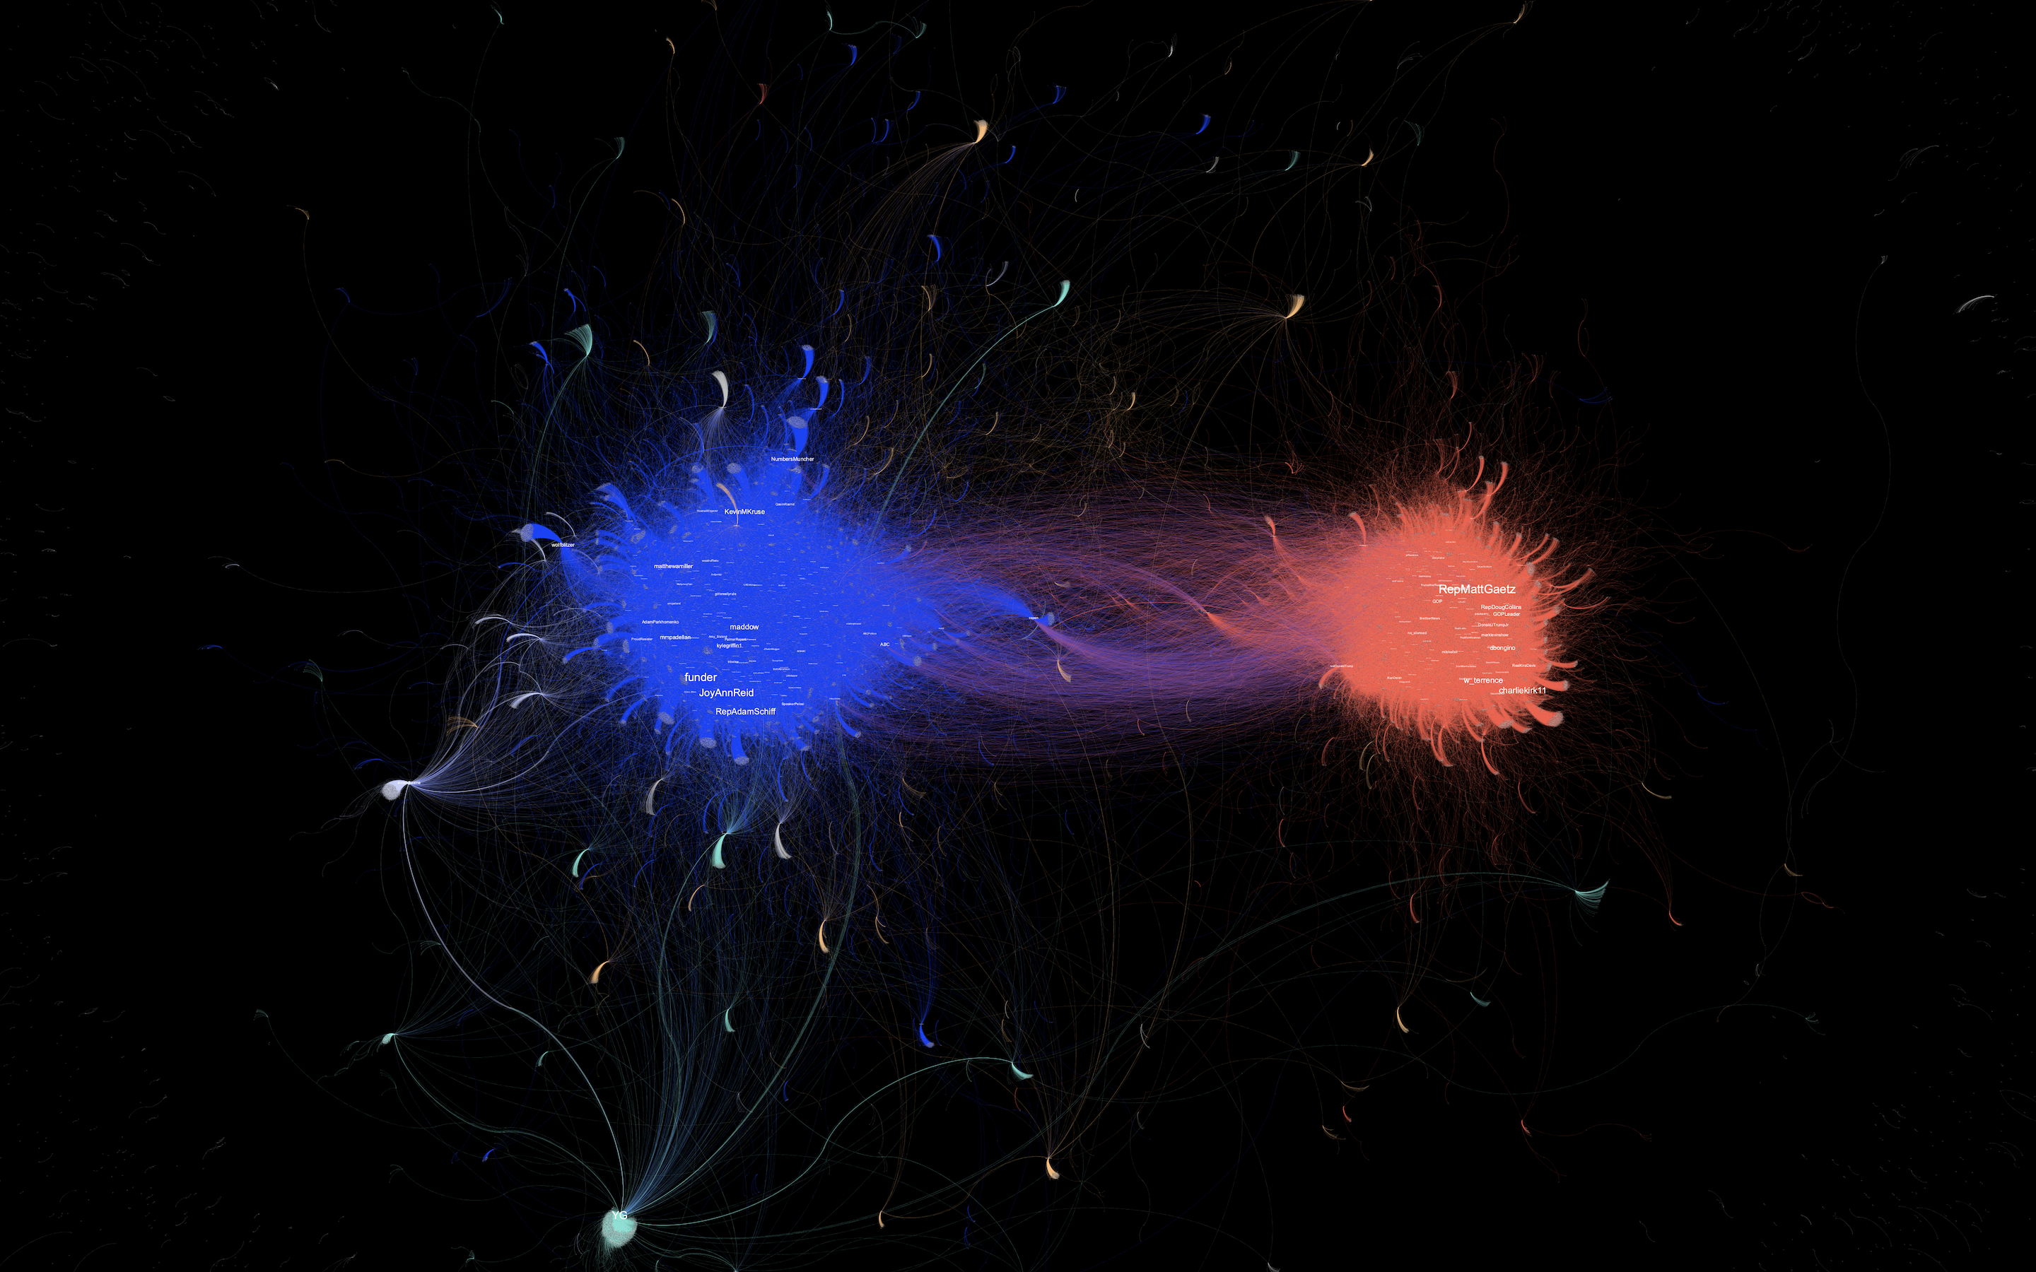
Graph Data: Interaction Networks
Polarity of Twitter handles from their interactions: https://towardsdatascience.com/a-radiography-of-trumps-impeachment-86284710ae1d

Slide 5
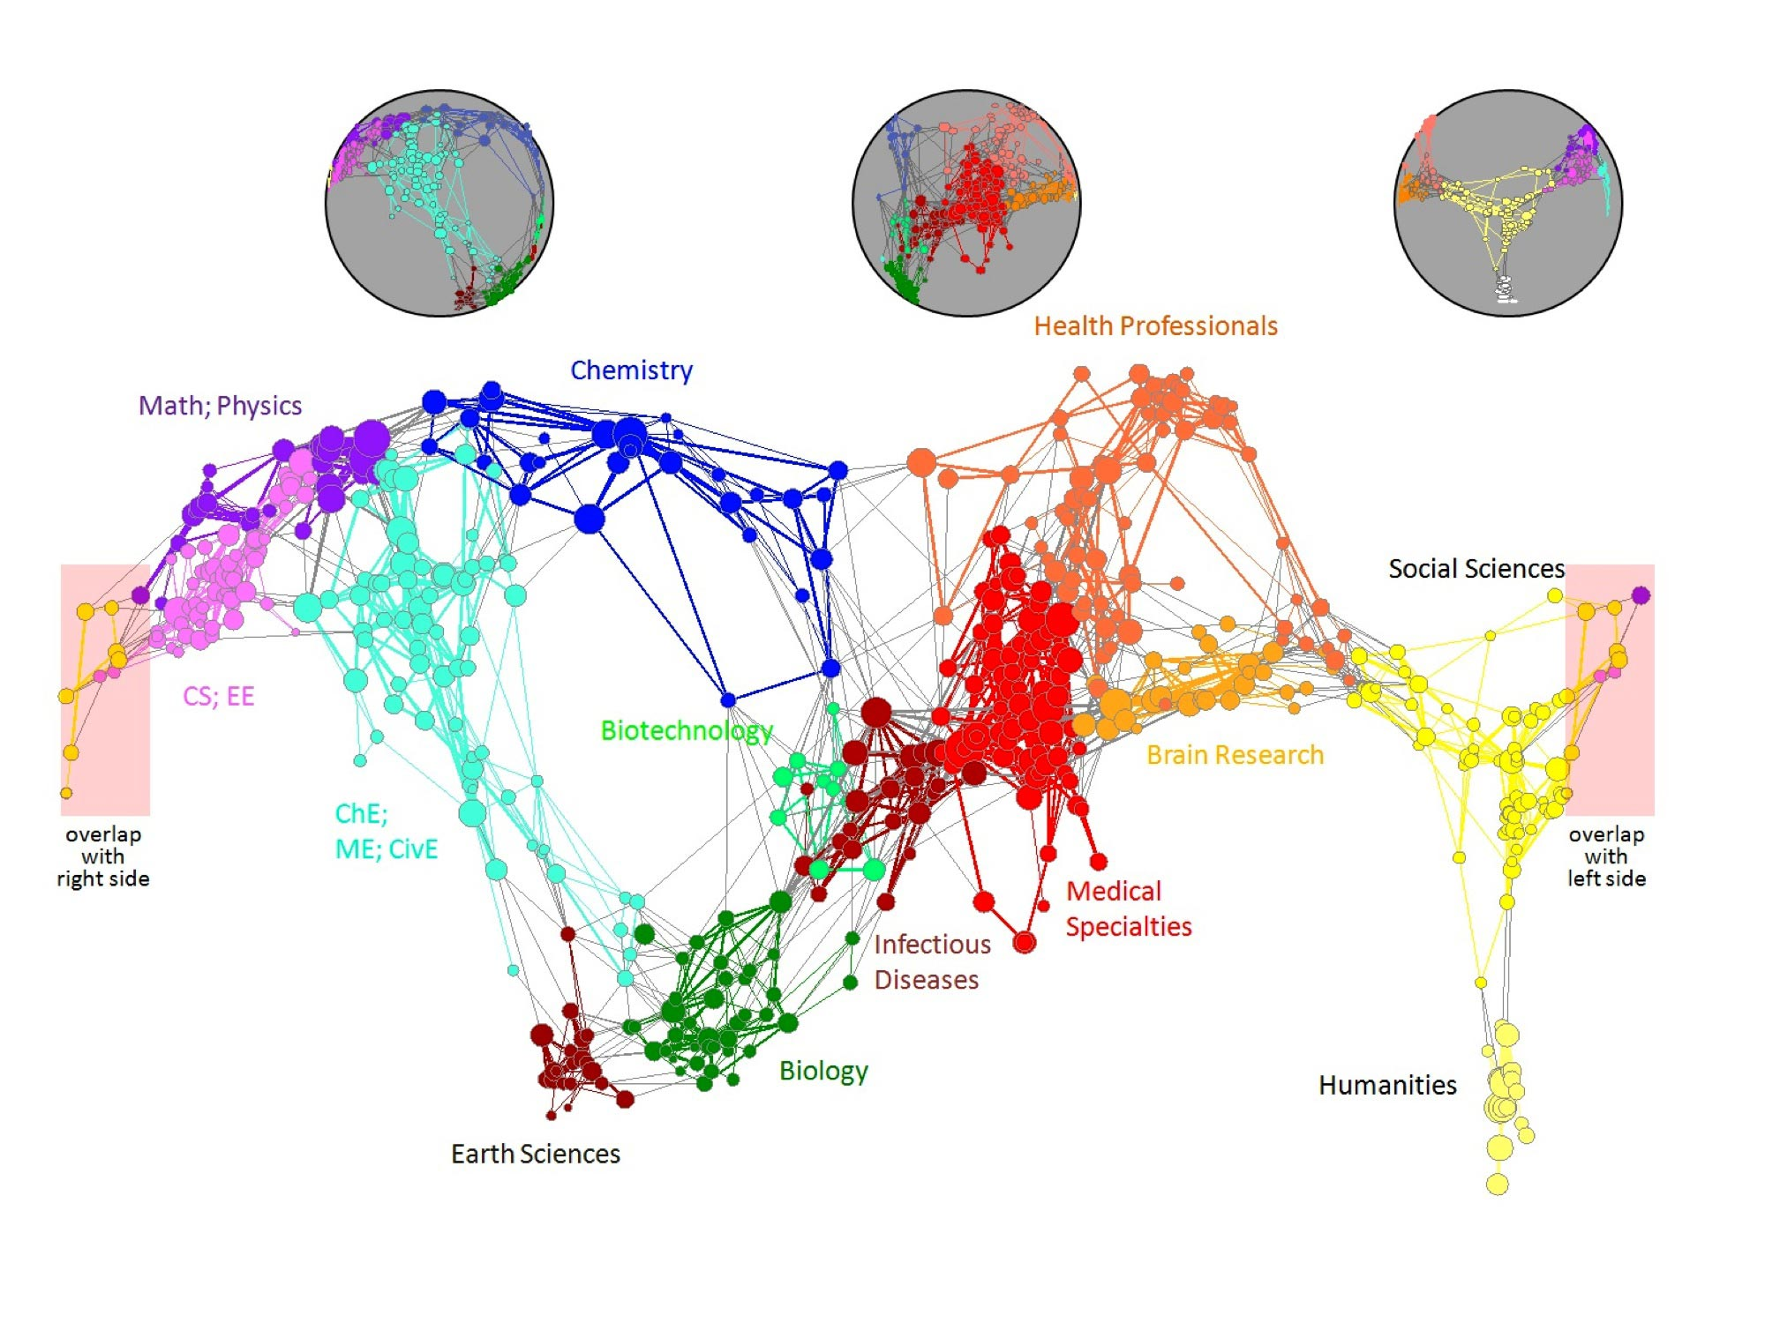
Graph Data: Information Networks
Citation networks and Maps of science
[Börner et al., 2012]

Slide 6
Graph Data: Communication Networks
domain2
domain1
router
domain3
INTERNET

Slide 7

Graph Data: Technological Networks
Seven Bridges of Königsberg [Euler, 1735]
Return to the starting point by traveling each link of the graph once and only once.

Slide 8
Web as a Graph
Web as a directed graph:
Nodes: Webpages
Edges: Hyperlinks
I teach Big Data Analytics course
CS 5683 course is scheduled in the Engineering South
Classroom buildings at OSU
Oklahoma State University

Slide 9
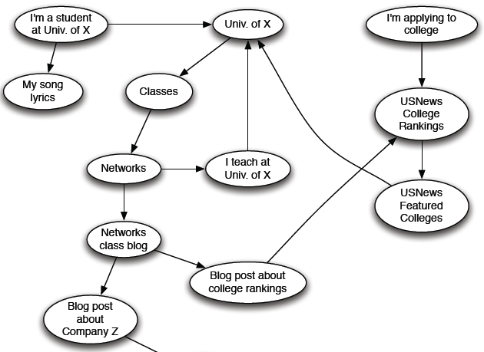
Web as a Directed Graph

Slide 10

Broad Question
How to organize the Web?
First try: Human curated Web directories
Yahoo, DMOZ, LookSmart
Second try: Web Search
Information Retrieval investigates: Find relevant docs in a small and trusted set
Newspaper articles, Patents, etc.
But: Web is huge, full of untrusted documents, random things, web spam, etc.

Slide 11
Web Search: 2 Challenges
2 challenges of web search:
(1) Web contains many sources of information Who to “trust”?
Trick: Trustworthy pages may point to each other!
(2) What is the “best” answer to query “newspaper”?
No single right answer
Trick: Pages that actually know about newspapers might all be pointing to many newspapers

Slide 12
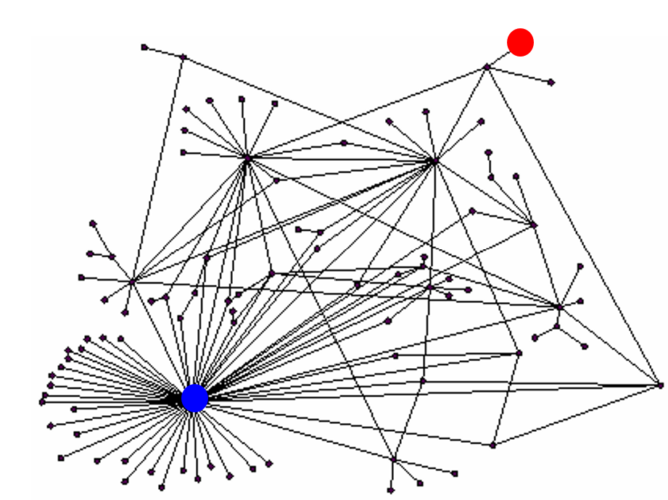
Ranking Nodes on the Graph
All web pages are not equally “important”
There is large diversity in the web-graph node connectivity.
Let’s rank the pages by the link structure!

Slide 13
Link Analysis Algorithms
We will cover the following Link Analysis approaches for computing importance of nodes in a graph:
Page Rank
Hubs and Authorities (HITS)
Topic-Specific (Personalized) Page Rank
Web Spam Detection Algorithms

Slide 14
PageRank – Links as Votes
Idea: Links as votes
Page is more important if it has more links
In-coming links? Out-going links?
Think of in-links as votes:
www.okstate.edu has 23,400 in-links
www.joe-schmoe.com has 1 in-link
Are all in-links are equal?
Links from important pages count more
Recursive question!

Slide 15
Example: PageRank Scores
B
38.4
C
34.3
A
3.3
D
3.9
E
8.1
F
3.9
1.6
1.6
1.6
1.6
1.6

Slide 16
Simple Recursive Formulation
Each link’s vote is proportional to the importance of its source page
If page j with importance r_{j} has n out-links, each link gets r_{j} / n votes
Page j’s own importance is the sum of the votes on its in-links
i
k
r_{i}/3
r_{k}/4
j
r_{j}/3
r_{j} = r_{i}/3+r_{k}/4
r_{j}/3
r_{j}/3

Slide 17
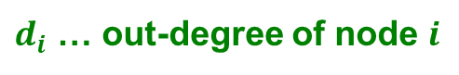
PageRank: The “Flow” Model
A “vote” from an important page is worth more
A page is important if it is pointed to by other important pages
Define a “rank” r_{j} for page j
y/2
y
a/2
y/2
m
a
m
a/2
$d_{i}$ … out-degree of node $i$
r_{y} = r_{y} /2 + r_{a} /2
r_{a} = r_{y} /2 + r_{m}
r_{m} = r_{a} /2

Slide 18
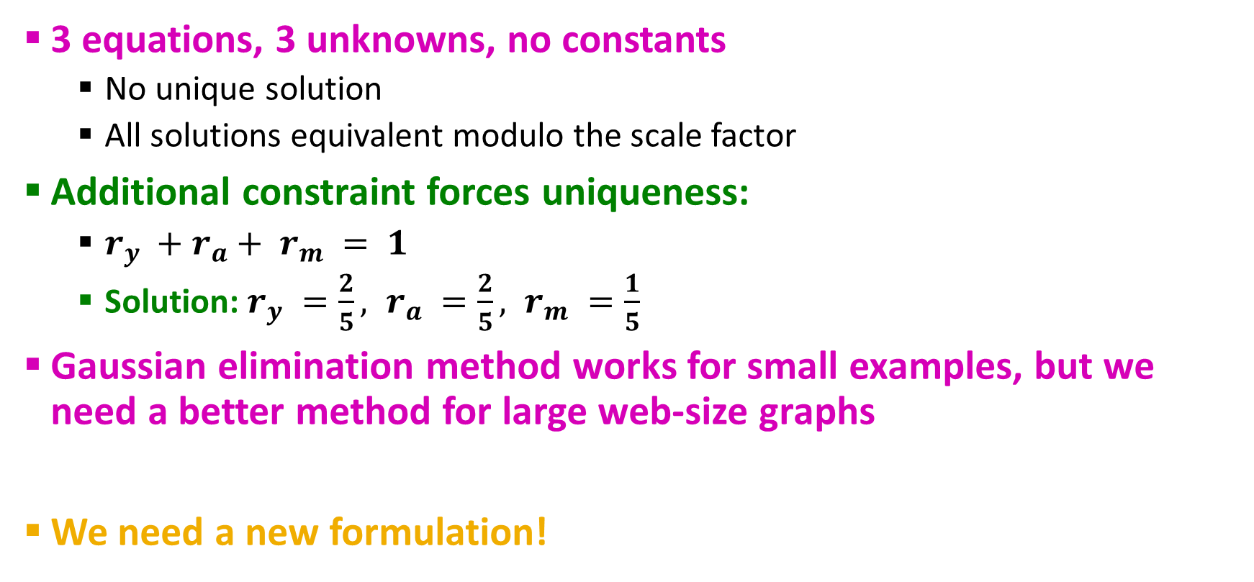
Solving the Flow Equations
3 equations, 3 unknowns, no constants
No unique solution
All solutions equivalent modulo the scale factor
Additional constraint forces uniqueness:
$r_{y} +r_{a}+ r_{m} = 1$
Solution: $r_{y} =\frac{2}{5}, r_{a} =\frac{2}{5}, r_{m} =\frac{1}{5}$
Gaussian elimination method works for small examples, but we need a better method for large web-size graphs
We need a new formulation!
Flow equations:
r_{y} = r_{y} /2 + r_{a} /2
r_{a} = r_{y} /2 + r_{m}
r_{m} = r_{a} /2

Slide 19
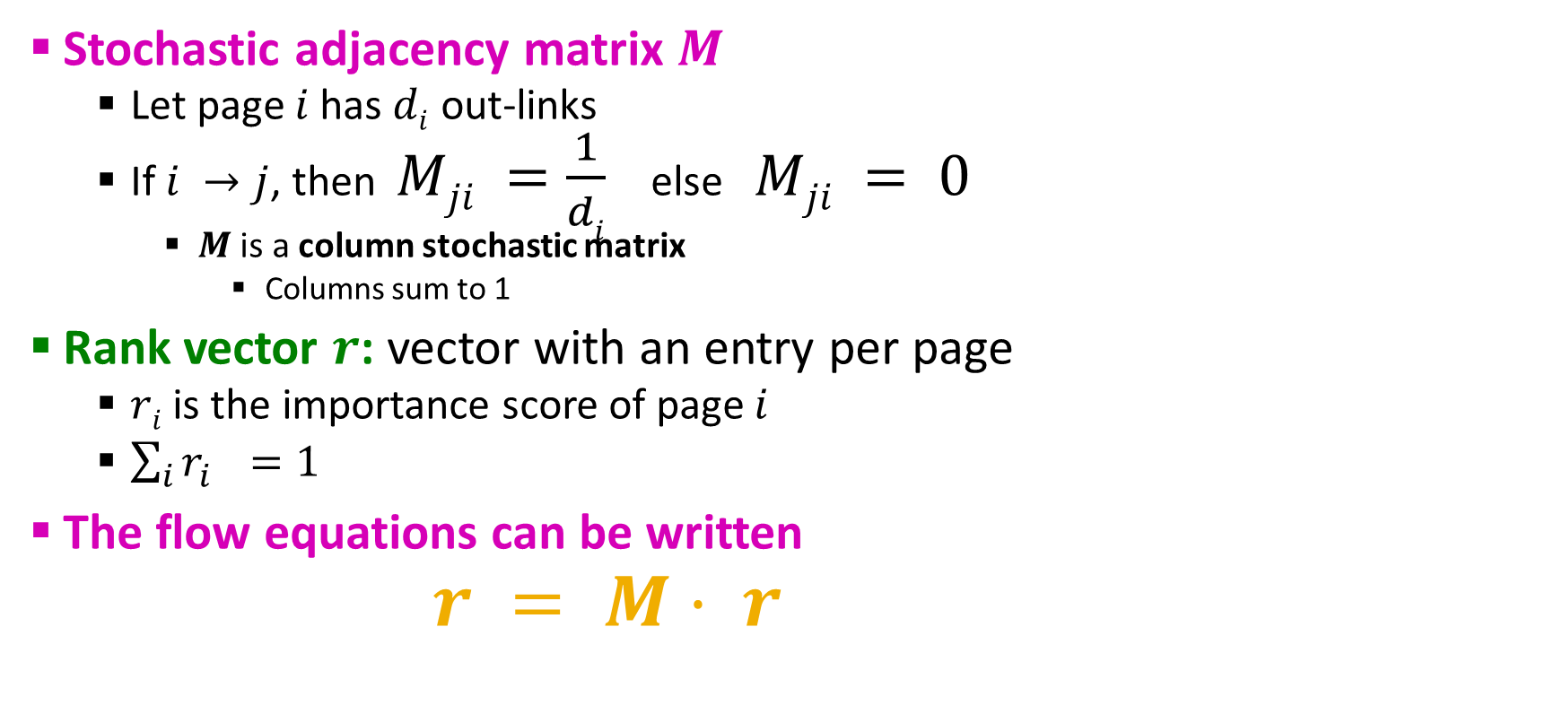
PageRank: Matrix Formulation
Stochastic adjacency matrix $M$
Let page $i$ has $di$ out-links
If $i →j$, then $Mji =\frac{1}{di}$ else $Mji = 0$
$M$ is a column stochastic matrix
Columns sum to 1
Rank vector $r$: vector with an entry per page
$ri$ is the importance score of page $i$
$\sum_{i}{r_{i}^{}=1}$
The flow equations can be written $r = M⋅ r$

Slide 20
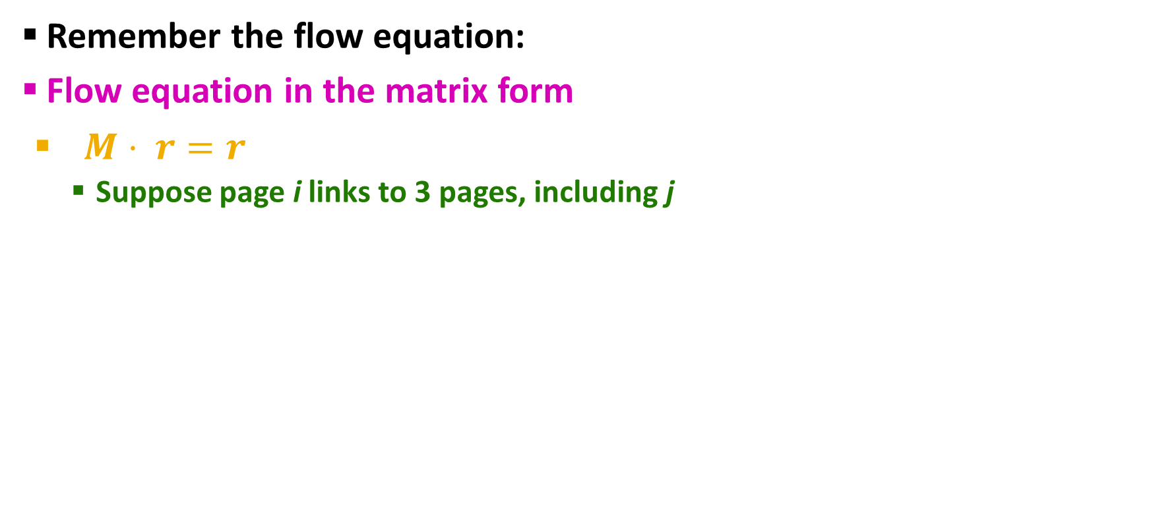
Example
Remember the flow equation:
Flow equation in the matrix form
$M⋅ r=r$
Suppose page i links to 3 pages, including j
i
j
r_{j}
.
=
r_{i}
1/3
M
.
r
=
r

Slide 21
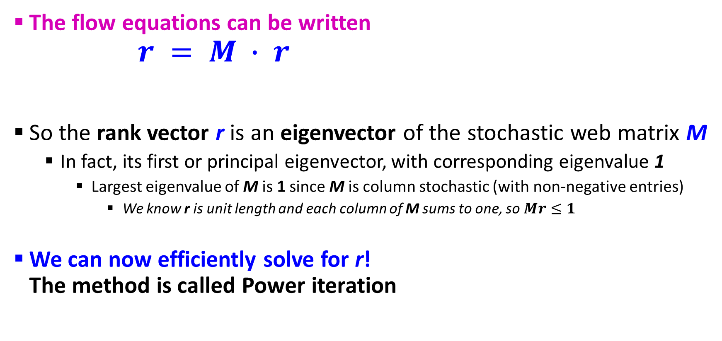
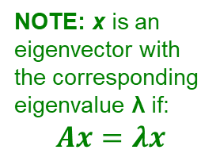
Eigenvector Formulation
The flow equations can be written $r = M ∙ r$
So the rank vector r is an eigenvector of the stochastic web matrix M
In fact, its first or principal eigenvector, with corresponding eigenvalue 1
Largest eigenvalue of M is 1 since M is column stochastic (with non-negative entries)
We know r is unit length and each column of M sums to one, so $Mr≤1$
We can now efficiently solve for r! The method is called Power iteration
NOTE: x is an eigenvector with the corresponding eigenvalue λ if: $$Ax=λx$$

Slide 22
Example: Flow Equations & M
 | y | a | m
y | ½ | ½ | 0
a | ½ | 0 | 1
m | 0 | ½ | 0
y
a
m
r = M∙r
r_{y} = r_{y} /2 + r_{a} /2
r_{a} = r_{y} /2 + r_{m}
r_{m} = r_{a} /2
y ½ ½ 0 y
a = ½ 0 1 a
m 0 ½ 0 m

Slide 23
Power Iteration Method
Given a web graph with n nodes, where the nodes are pages and edges are hyperlinks
Power iteration: a simple iterative scheme
Suppose there are N web pages
Initialize: r⁽⁰⁾ = [1/N,….,1/N]^{T}
Iterate: r^{(t+1)} = M ∙ r^{(t)}
Stop when |r^{(t+1)} – r^{(t)}|₁ < ε
d_{i} …. out-degree of node i
|x|₁ = ∑_{1≤i≤N}|x_{i}| is the L1 norm
Can use any other vector norm, e.g., Euclidean

Slide 24
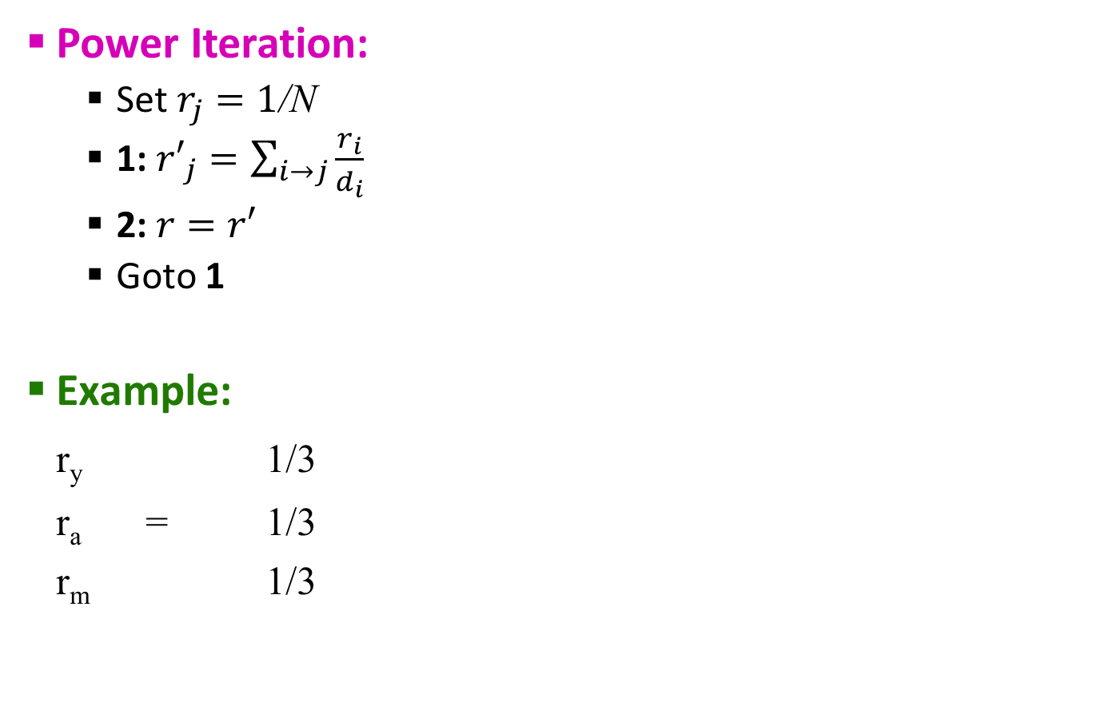
PageRank: How to solve?
Power Iteration:
Set $r_{j}=1$/N
1: ${r′}_{j}=\sum_{i→j}{\frac{r_{i}}{d_{i}}}$
2:$r=r′$
Goto 1
Example:
r_{y} 1/3
r_{a} = 1/3
r_{m} 1/3
y
 | y | a | m
y | ½ | ½ | 0
a | ½ | 0 | 1
m | 0 | ½ | 0
a
m
r_{y} = r_{y} /2 + r_{a} /2
r_{a} = r_{y} /2 + r_{m}
r_{m} = r_{a} /2
Iteration 0, 1, 2, …

Slide 25

PageRank: How to solve?
Power Iteration:
Set $r_{j}=1$/N
1: ${r′}_{j}=\sum_{i→j}{\frac{r_{i}}{d_{i}}}$
2:$r=r′$
Goto 1
Example:
r_{y} 1/3 1/3 5/12 9/24 6/15
r_{a} = 1/3 3/6 1/3 11/24 … 6/15
r_{m} 1/3 1/6 3/12 1/6 3/15
y
 | y | a | m
y | ½ | ½ | 0
a | ½ | 0 | 1
m | 0 | ½ | 0
a
m
r_{y} = r_{y} /2 + r_{a} /2
r_{a} = r_{y} /2 + r_{m}
r_{m} = r_{a} /2
Iteration 0, 1, 2, …

Slide 26
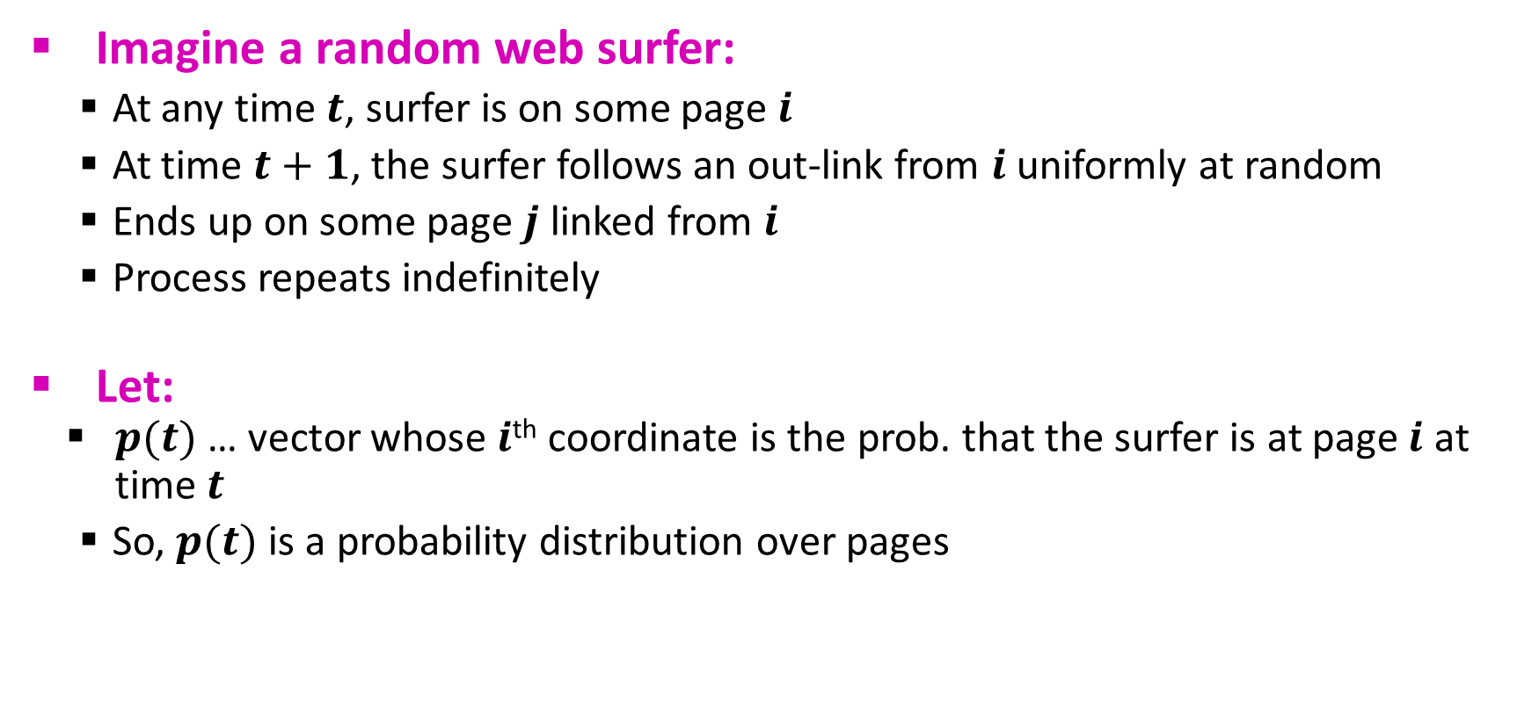
Random Walk Interpretation
i₁
i₂
i₃
j
Imagine a random web surfer:
At any time $t$, surfer is on some page $i$
At time $t+1$, the surfer follows an out-link from $i$ uniformly at random
Ends up on some page $j$ linked from $i$
Process repeats indefinitely
Let:
$p(t)$ … vector whose $i$^{th} coordinate is the prob. that the surfer is at page $i$ at time $t$
So, $p(t)$ is a probability distribution over pages

Slide 27
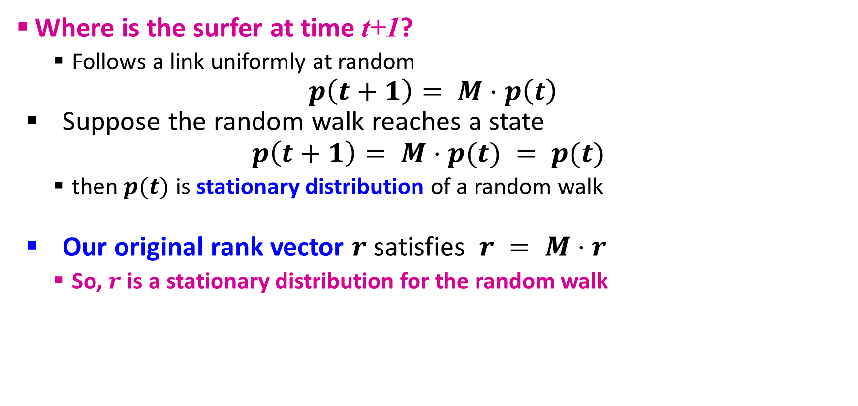
The Stationary Distribution
i₁
i₂
i₃
j
Where is the surfer at time t+1?
Follows a link uniformly at random
$$p\left(t+1\right)= M⋅p\left(t\right)$$
Suppose the random walk reaches a state
$$p\left(t+1\right)= M⋅p(t) = p(t)$$
then $p(t)$ is stationary distribution of a random walk
Our original rank vector $r$ satisfies $r = M⋅r$
So, $r$ is a stationary distribution for the random walk

Slide 28
Existence and Uniqueness
A central result from the theory of random walks (a.k.a. Markov processes):
For graphs that satisfy certain conditions, the stationary distribution is unique and eventually will be reached no matter what the initial probability distribution at time t = 0

Slide 29
PageRank: Three Questions
or
equivalently
Does this converge?
Does it converge to what we want?
Are results reasonable?

Slide 30
1. Does this converge?
a
b
Example:
r_{a} 1 0 1 0
r_{b} 0 1 0 1
Iteration 0, 1, 2, …

Slide 31
2. Does this converge to what we want?
a
b
Example:
r_{a} 1 0 1 0
r_{b} 0 1 0 1
Iteration 0, 1, 2, …

Slide 32
PageRank: Problems
Dead end
2 problems:
(1) Some pages are dead ends (have no out-links)
Random walk has “nowhere” to go to
Such pages cause importance to “leak out”
(2) Spider traps: (all out-links are within the group)
Random walked gets “stuck” in a trap
And eventually spider traps absorb all importance
Spider trap

Slide 33
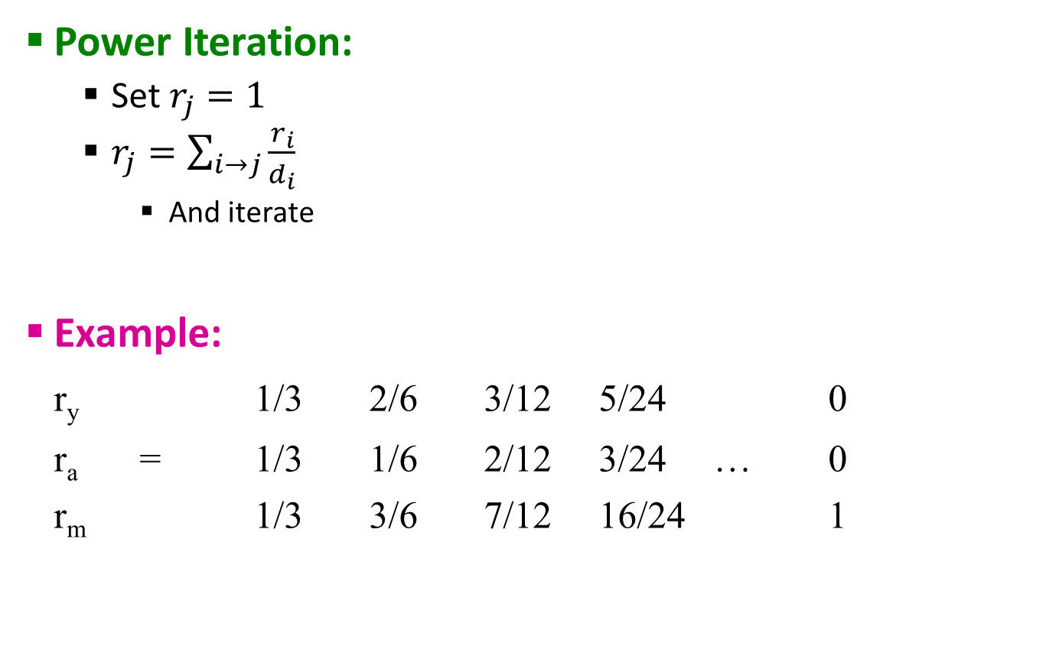
Problem: Spider Traps
 | y | a | m
y | ½ | ½ | 0
a | ½ | 0 | 0
m | 0 | ½ | 1
Power Iteration:
Set $r_{j}=1$
$r_{j}=\sum_{i→j}{\frac{r_{i}}{d_{i}}}$
And iterate
Example:
r_{y} 1/3 2/6 3/12 5/24 0
r_{a} = 1/3 1/6 2/12 3/24 … 0
r_{m} 1/3 3/6 7/12 16/24 1
y
a
m
r_{y} = r_{y} /2 + r_{a} /2
r_{a} = r_{y} /2
r_{m} = r_{a} /2 + r_{m}
m is a spider trap
Iteration 0, 1, 2, …
All the PageRank score gets “trapped” in node m.

Slide 34
Solution: Teleports!
The Google solution for spider traps: At each time step, the random surfer has two options
With prob. β, follow a link at random
With prob. 1-β, jump to some random page
Common values for β are in the range 0.8 to 0.9
Surfer will teleport out of spider trap within a few time steps
y
y
a
m
a
m

Slide 35

Problem: Dead Ends
 | y | a | m
y | ½ | ½ | 0
a | ½ | 0 | 0
m | 0 | ½ | 0
Power Iteration:
Set $r_{j}=1$
$r_{j}=\sum_{i→j}{\frac{r_{i}}{d_{i}}}$
And iterate
Example:
r_{y} 1/3 2/6 3/12 5/24 0
r_{a} = 1/3 1/6 2/12 3/24 … 0
r_{m} 1/3 3/6 7/12 16/24 0
y
a
m
r_{y} = r_{y} /2 + r_{a} /2
r_{a} = r_{y} /2
r_{m} = r_{a} /2 + r_{m}
Iteration 0, 1, 2, …
Here the PageRank “leaks” out since the matrix is not stochastic.

Slide 36
Solution: Always Teleport!
Teleports: Follow random teleport links with probability 1.0 from dead-ends
Adjust matrix accordingly
y
y
a
m
a
m
 | y | a | m
y | ½ | ½ | 0
a | ½ | 0 | 0
m | 0 | ½ | 0
 | y | a | m
y | ½ | ½ | ⅓
a | ½ | 0 | ⅓
m | 0 | ½ | ⅓

Slide 37
Why Teleports Solve the Problem?
Why are dead-ends and spider traps a problem and why do teleports solve the problem?
Spider-traps are not a problem, but with traps PageRank scores are not what we want
Solution: Never get stuck in a spider trap by teleporting out of it in a finite number of steps
Dead-ends are a problem
The matrix is not column stochastic so our initial assumptions are not met
Solution: Make matrix column stochastic by always teleporting when there is nowhere else to go

Slide 38
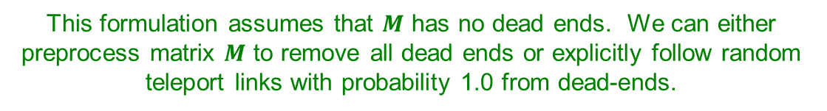
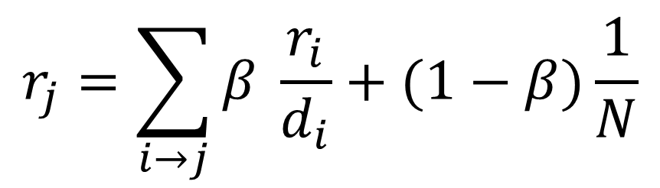
Solution: Random Teleports
Google’s solution that does it all: At each step, random surfer has two options:
With probability β, follow a link at random
With probability 1-β, jump to some random page
PageRank equation [Brin-Page, 98]
$$r_{j}=\sum_{i→j}{β \frac{r_{i}}{d_{i}}}+(1−β)\frac{1}{N}$$
d_{i} … out-degree of node i
This formulation assumes that $M$ has no dead ends. We can either preprocess matrix $M$ to remove all dead ends or explicitly follow random teleport links with probability 1.0 from dead-ends.

Slide 39
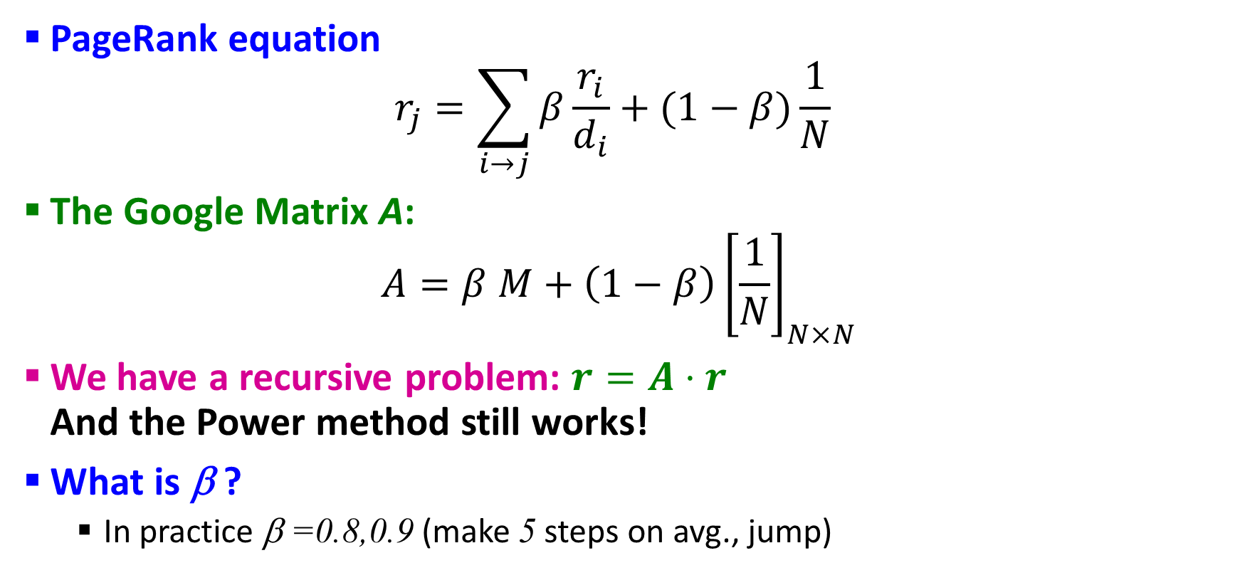
The Google Matrix
PageRank equation $r_{j}=\sum_{i→j}{β\frac{r_{i}}{d_{i}}}+(1−β)\frac{1}{N}$
The Google Matrix A:
$$A=β M+\left(1−β\right){\left[\frac{1}{N}\right]}_{N×N}$$
We have a recursive problem: $r=A⋅r$ And the Power method still works!
What is β ?
In practice β =0.8,0.9 (make 5 steps on avg., jump)
[1/N]_{NxN}…N by N matrix where all entries are 1/N

Slide 40

Random Teleports ($β$=0.8)
M
[1/N]_{NxN}
7/15
y
1/2 1/2 0
1/2 0 0
0 1/2 1
1/3 1/3 1/3
1/3 1/3 1/3
1/3 1/3 1/3
0.8
+ 0.2
7/15
1/15
7/15
1/15
y 7/15 7/15 1/15
a 7/15 1/15 1/15
m 1/15 7/15 13/15
13/15
a
7/15
m
1/15
1/15
A
y
a =
m
1/3
1/3
1/3
0.33
0.20
0.46
0.24
0.20
0.52
0.26
0.18
0.56
7/33
5/33
21/33
. . .

Slide 41
How do we actually compute PageRank?
Key step is matrix-vector multiplication
r^{new} = A ∙ r^{old}
Easy if we have enough main memory to hold A, r^{old}, r^{new}
Say N = 1 billion pages
We need 4 bytes for each entry (say)
2 billion entries for vectors, approx 8GB
Matrix A has N² entries
10¹⁸ is a large number!
A = β∙M + (1-β) [1/N]_{NxN}
½ ½ 0
½ 0 0
0 ½ 1
1/3 1/3 1/3
1/3 1/3 1/3
1/3 1/3 1/3
A =
0.8
+0.2
7/15 7/15 1/15
7/15 1/15 1/15
1/15 7/15 13/15
=

Slide 42
Matrix Formulation
Suppose there are N pages
Consider page i, with d_{i} out-links
We have M_{ji} = 1/|d_{i}| when i → j and M_{ji} = 0 otherwise
The random teleport is equivalent to:
Adding a teleport link from i to every other page and setting transition probability to (1-β)/N
Reducing the probability of following each out-link from 1/|d_{i}| to β/|d_{i}|
Equivalent: Tax each page a fraction (1-β) of its score and redistribute evenly

Slide 43
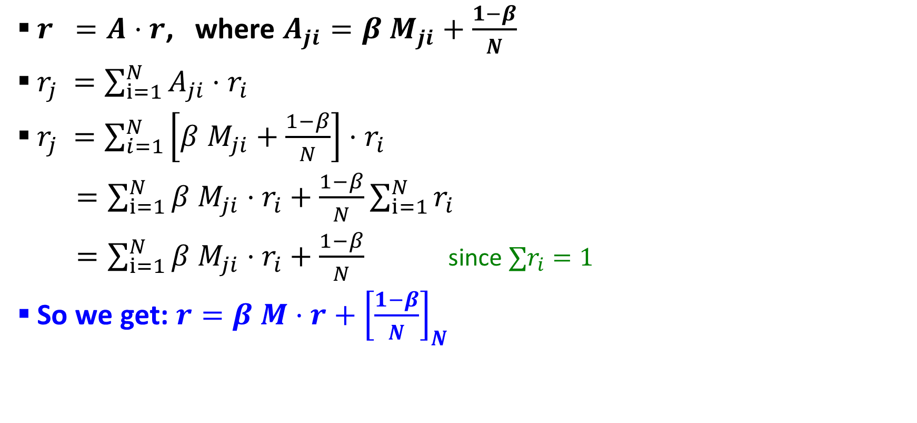
Rearranging the Equation
$r =A⋅r$, where $A_{ji}=β{ M}_{ji}+\frac{1−β}{N}$
$r_{j} =\sum_{i=1}^{N}{A_{ji}⋅r_{i}}$
$r_{j} =\sum_{i=1}^{N}{\left[β{ M}_{ji}+\frac{1−β}{N}\right]⋅r_{i}}$
$=\sum_{i=1}^{N}{β{ M}_{ji}⋅r_{i}+\frac{1−β}{N}}\sum_{i=1}^{N}{r_{i}}$
$=\sum_{i=1}^{N}{β{ M}_{ji}⋅r_{i}+\frac{1−β}{N}}$ since $∑r_{i}=1$
So we get: $r=β M⋅r+{\left[\frac{1−β}{N}\right]}_{N}$
Note: Here we assumed M has no dead-ends
[x]_{N} … a vector of length N with all entries x

Slide 44
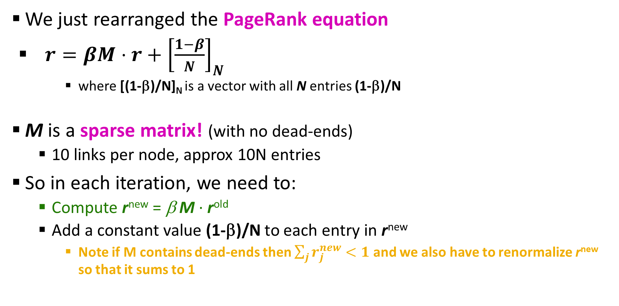
Sparse Matrix Formulation
We just rearranged the PageRank equation
$r=βM⋅r+{\left[\frac{1−β}{N}\right]}_{N}$
where [(1-β)/N]_{N} is a vector with all N entries (1-β)/N
M is a sparse matrix! (with no dead-ends)
10 links per node, approx 10N entries
So in each iteration, we need to:
Compute r^{new} = β M ∙ r^{old}
Add a constant value (1-β)/N to each entry in r^{new}
Note if M contains dead-ends then $\sum_{j}{r_{j}^{new}}<1$ and we also have to renormalize r^{new} so that it sums to 1

Slide 45
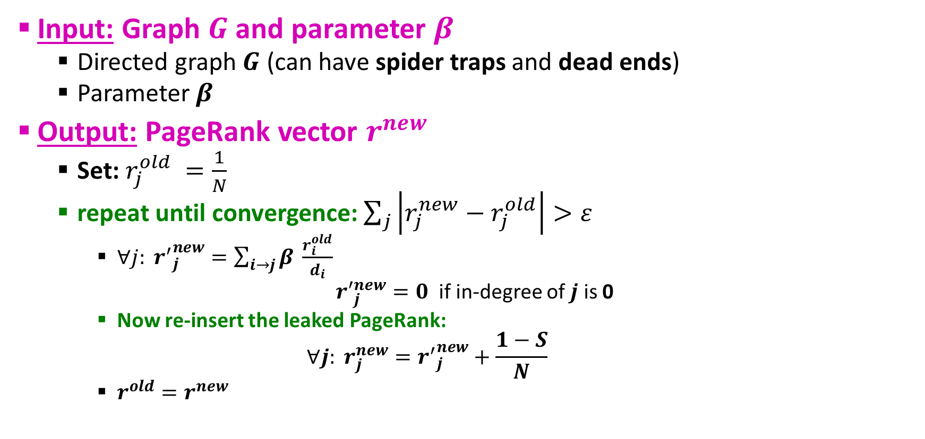
PageRank: The Complete Algorithm
Input: Graph $G$ and parameter $β$
Directed graph $G$ (can have spider traps and dead ends)
Parameter $β$
Output: PageRank vector $r^{new}$
Set: $r_{j}^{old} =\frac{1}{N}$
repeat until convergence: $\sum_{j}{\left|r_{j}^{new}−r_{j}^{old}\right|>ε}$
$∀j: {r^{′}}_{j}^{new}=\sum_{i→j}{β \frac{r_{i}^{old}}{d_{i}}}$
${r′}_{j}^{new}=0$ if in-degree of $j$ is 0
Now re-insert the leaked PageRank:
$$∀j: r_{j}^{new}={r^{′}}_{j}^{new}+\frac{1−S}{N}$$
$r^{old}=r^{new}$
If the graph has no dead-ends then the amount of leaked PageRank is 1-β. But since we have dead-ends the amount of leaked PageRank may be larger. We have to explicitly account for it by computing S.

Slide 46
Sparse Matrix Encoding
Encode sparse matrix using only nonzero entries
Space proportional roughly to number of links
Say 10N, or 4*10*1 billion = 40GB
Still won’t fit in memory, but will fit on disk
source
node
degree
destination nodes
0 | 3 | 1, 5, 7
1 | 5 | 17, 64, 113, 117, 245
2 | 2 | 13, 23

Slide 47
Basic Algorithm: Update Step
Assume enough RAM to fit r^{new} into memory
Store r^{old} and matrix M on disk
1 step of power-iteration is:
Initialize all entries of r^{new} = (1-β) / N
For each page i (of out-degree d_{i}):
Read into memory: i, d_{i}, dest₁, …, dest_{di}, r^{old}(i)
For j = 1…d_{i}
r^{new}(dest_{j}) += β r^{old}(i) / d_{i}
0
r^{new}
source
degree
destination
r^{old}
0
1
0 | 3 | 1, 5, 6
1 | 4 | 17, 64, 113, 117
2 | 2 | 13, 23
1
2
2
3
3
4
4
5
5
6
6

Slide 48
Analysis
Assume enough RAM to fit r^{new} into memory
Store r^{old} and matrix M on disk
In each iteration, we have to:
Read r^{old} and M
Write r^{new} back to disk
Cost per iteration of Power method: = 2|r| + |M|
Question:
What if we could not even fit r^{new} in memory?

Slide 49
Block-based Update Algorithm
r^{new}
src
degree
destination
r^{old}
0
0 | 4 | 0, 1, 3, 5
1 | 2 | 0, 5
2 | 2 | 3, 4
0
1
1
2
2
3
4
3
M
5
4
5
Break r^{new} into k blocks that fit in memory
Scan M and r^{old} once for each block

Slide 50
Analysis of Block Update
Similar to nested-loop join in databases
Break r^{new} into k blocks that fit in memory
Scan M and r^{old} once for each block
Total cost:
k scans of M and r^{old}
Cost per iteration of Power method: k(|M| + |r|) + |r| = k|M| + (k+1)|r|
Can we do better?
Hint: M is much bigger than r (approx 10-20x), so we must avoid reading it k times per iteration

Slide 51
Block-Stripe Update Algorithm
src
degree
destination
r^{new}
0 | 4 | 0, 1
1 | 3 | 0
2 | 2 | 1
0
1
r^{old}
0
1
2
2
0 | 4 | 3
2 | 2 | 3
3
4
3
5
0 | 4 | 5
1 | 3 | 5
2 | 2 | 4
4
5
Break M into stripes! Each stripe contains only destination nodes in the corresponding block of r^{new}

Slide 52
Block-Stripe Analysis
Break M into stripes
Each stripe contains only destination nodes in the corresponding block of r^{new}
Some additional overhead per stripe
But it is usually worth it
Cost per iteration of Power method =|M|(1+ε) + (k+1)|r|

Slide 53
Some Problems with PageRank
Measures generic popularity of a page
Biased against topic-specific authorities
Solution: Topic-Specific PageRank (next)
Uses a single measure of importance
Other models of importance
Solution: Hubs-and-Authorities
Susceptible to Link spam
Artificial link topographies created in order to boost page rank
Solution: TrustRank

Slide 54

Questions???

Slide 55
Acknowledgements
Most of this lecture slides are obtained from the Mining Massive Datasets course: http://www.mmds.org/

